Slide 1
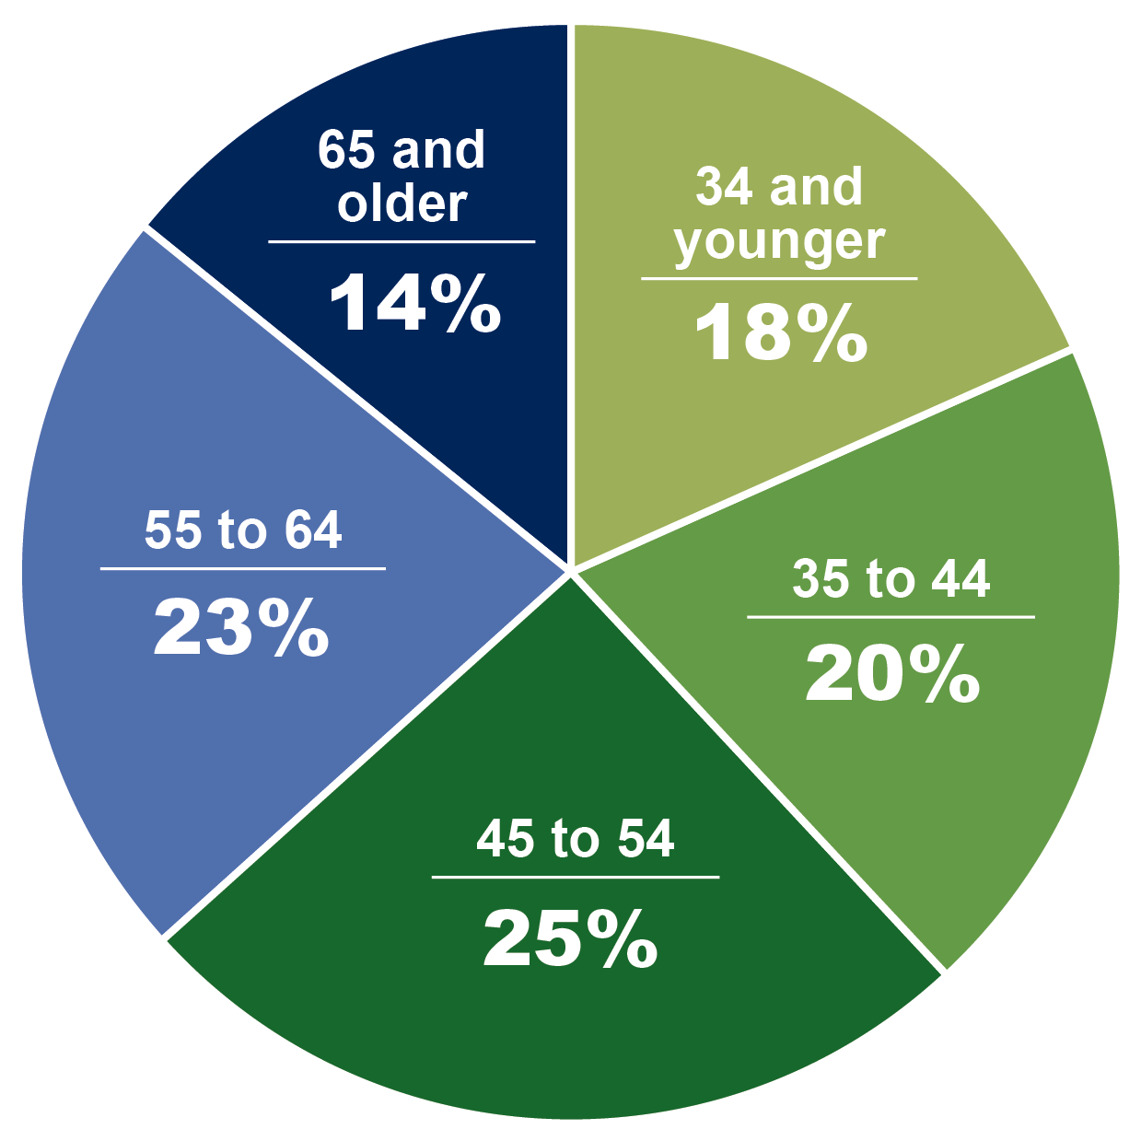
Beginning farmers come in all ages. Sixty-two percent are 45 and older.
Source: U.S. Department of Agriculture, National Agricultural Statistics Service, 2012 Census of Agriculture. Compiled by the Farmland Information Center – www.farmlandinfo.org

